Slide 1
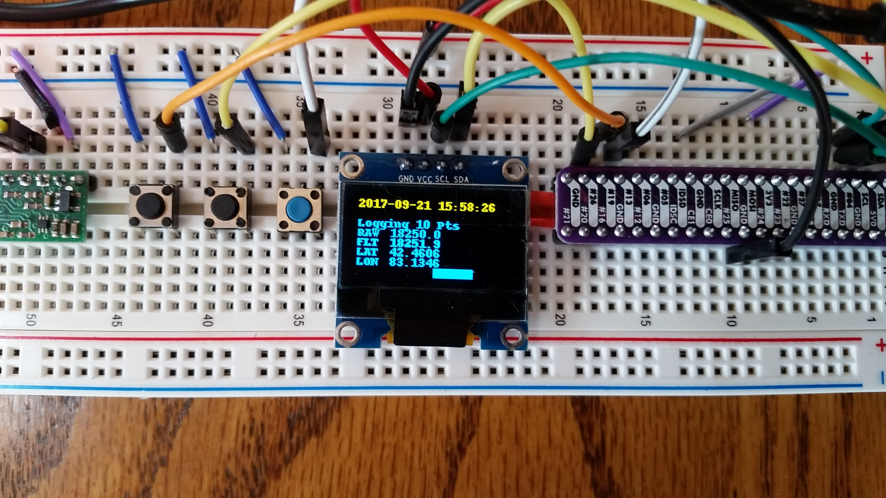
StandBy
Log Data
Shutdown
Horizontal Bar Graph of Accel (+/- 2g)

